Slide 1

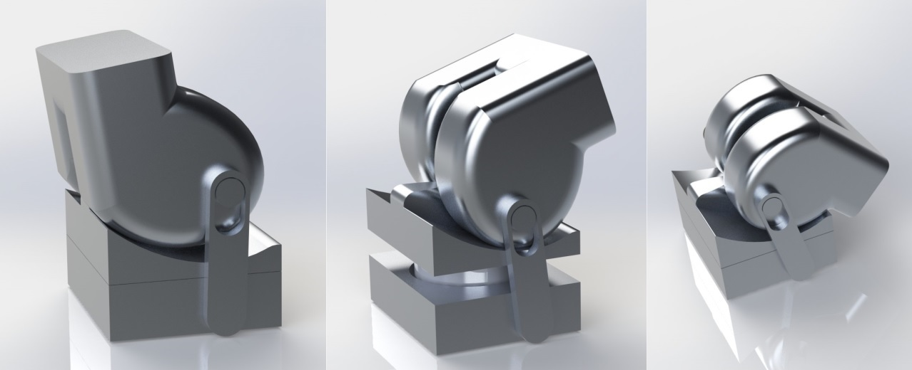
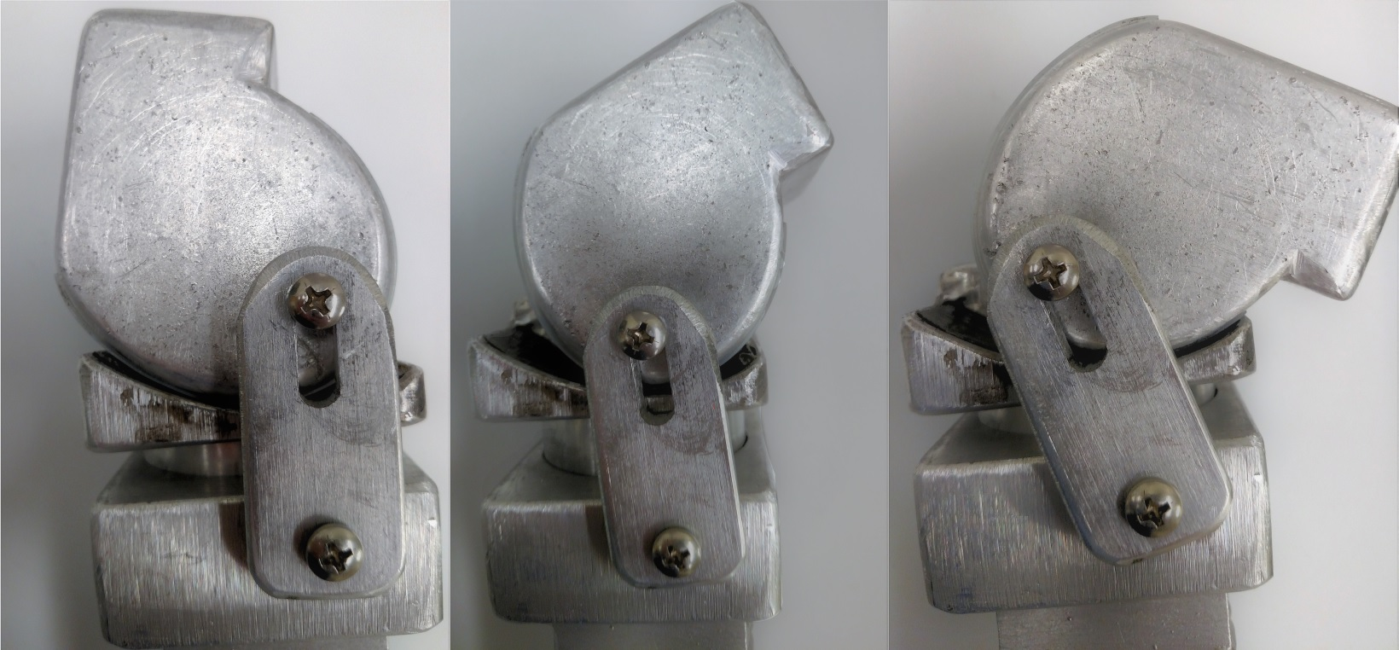
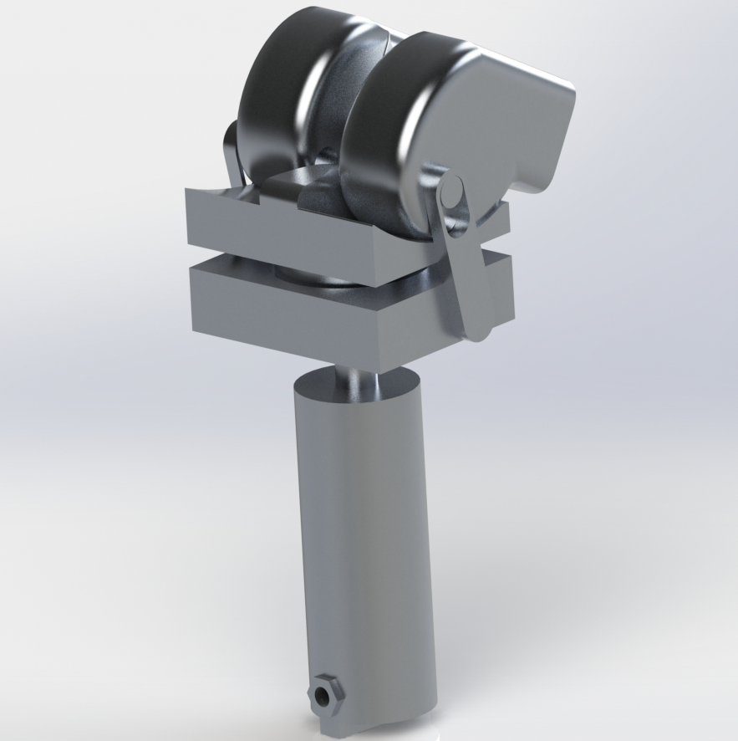
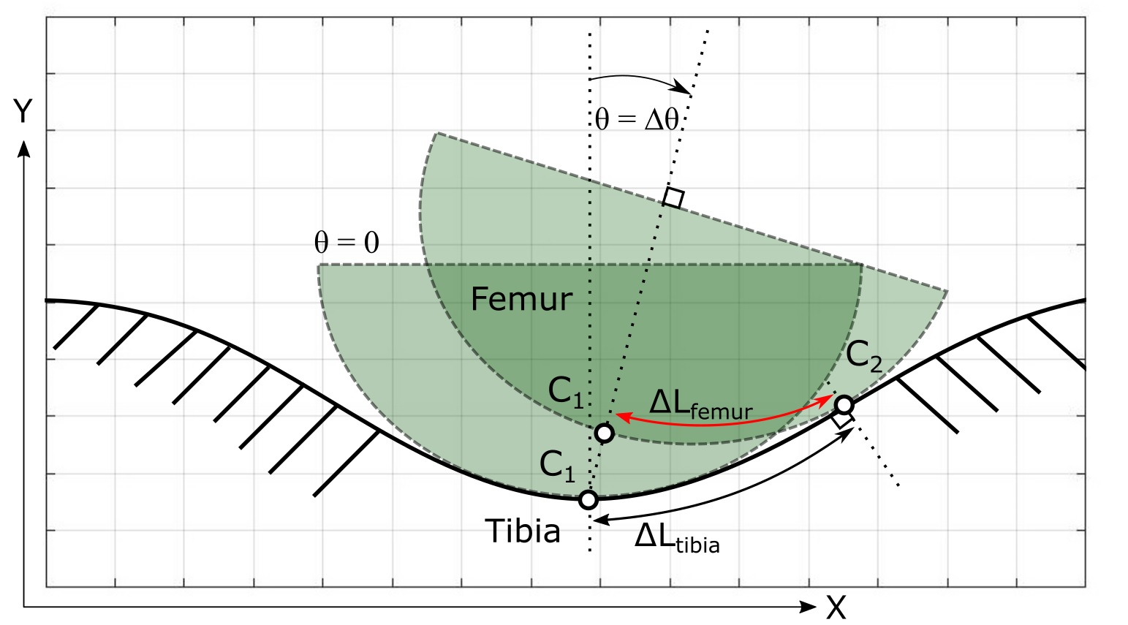
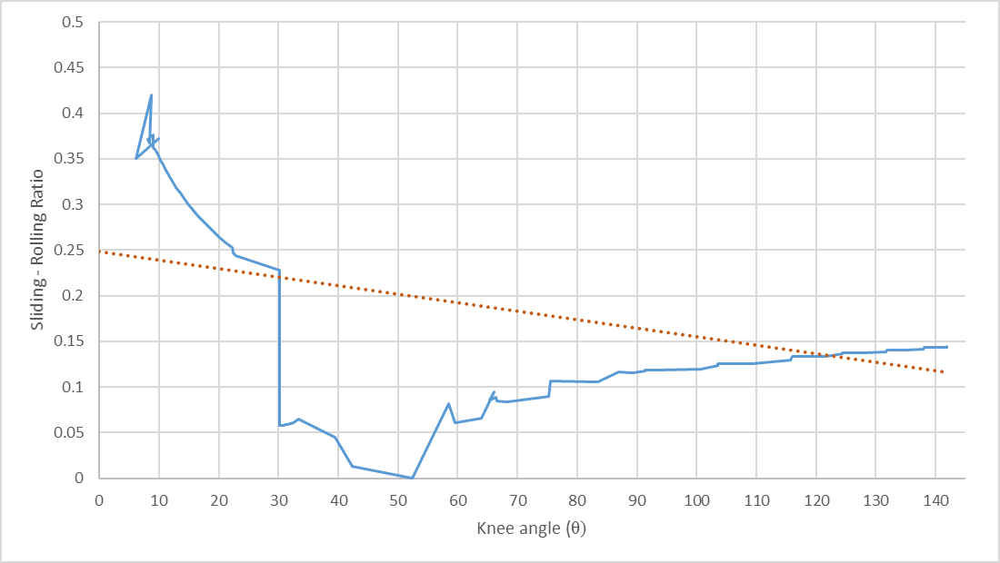
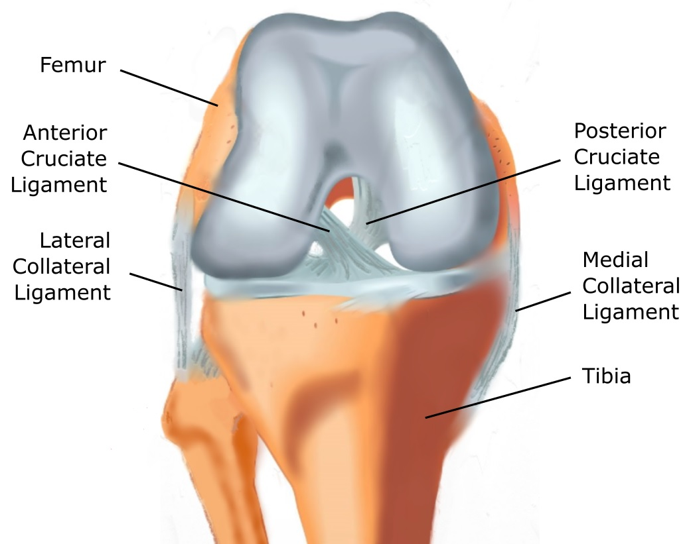
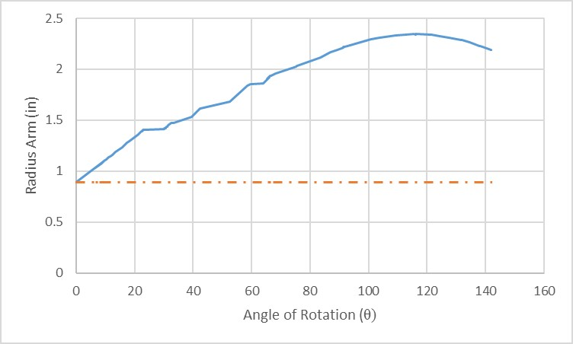
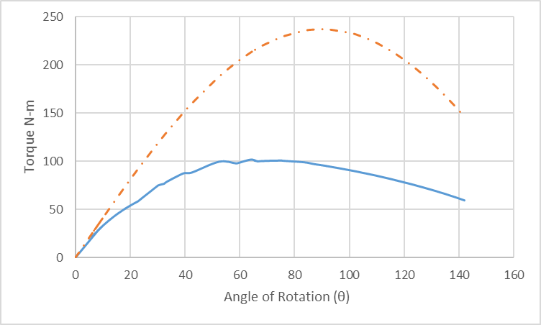
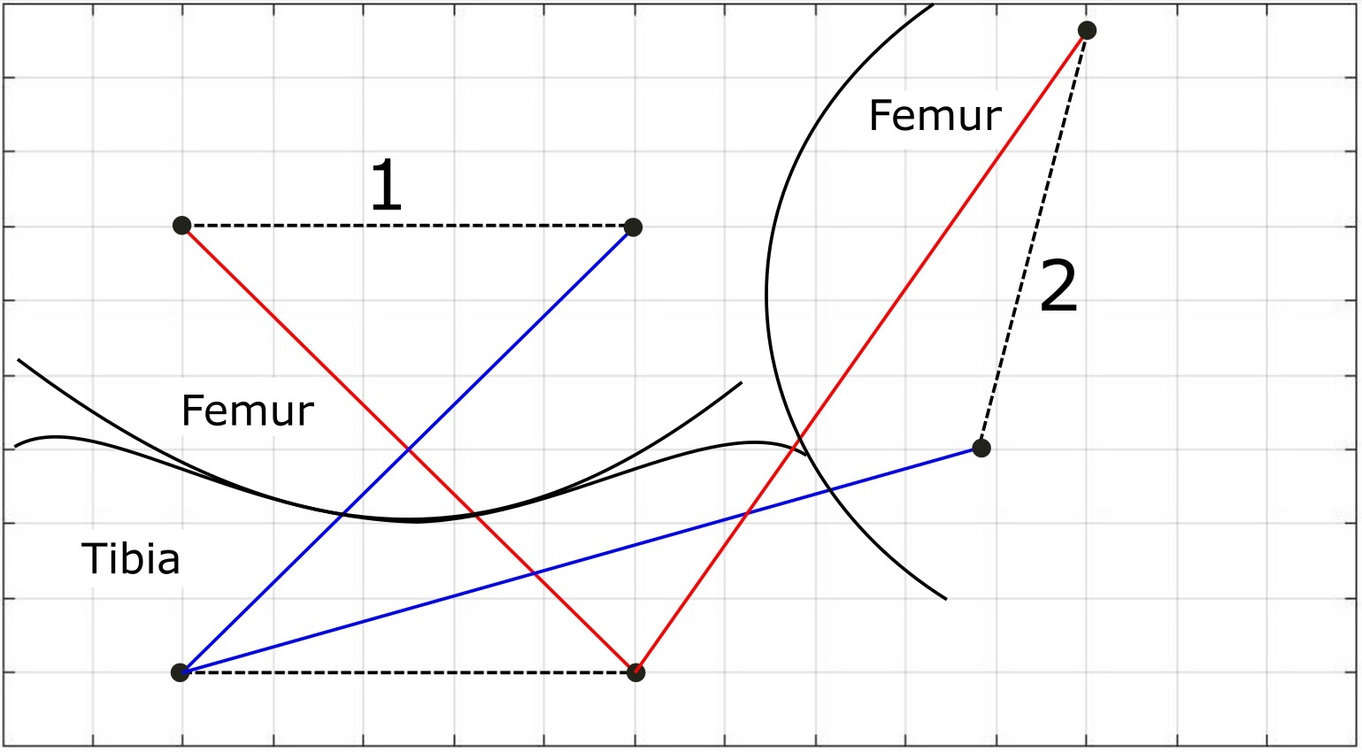
Development of a Bio-inspired
Knee Joint Mechanism for a Bipedal Robot
Alexander G. Steele¹, Alexander Hunt¹, and Appolinaire Etoundi²
1) Dept. of Mechanical Engineering and 2) Bristol Robotics Laboratory, University of the West of England, Bristol
Abstract
Design and Construction
References
Z.-K. Ling, H. Guo, and S. Boersma, “Analytical study on the kinematic and dynamic behaviors of a knee joint,” Med. Eng. Phys., vol. 19, no. 1, pp. 29–36, Jan.1997.
S. D. Masouros, A. M. J. Bull, and A. A. Amis, “Biomechanics of the knee joint,” Orthop. TRAUMA, vol. 24, no. 2, pp. 84–91, Apr. 2010.
G. Fekete, “Kinetics and Kinematics of the Human Knee Joint under Standard and Non-Standard Squat Movement,” Ghent University, 2013.
Appolinaire C. Etoundi, “A bio-inspired condylar hinge joint for mobile robots,” Int. Conf. Intell. Robots Syst., Sep. 2011.
A. Etoundi, S. Burgess, and R. Vaidyanathan, “A Bio-Inspired Condylar Hinge for Robotic Limbs,” J. Mech. Robot., vol. 5, p. 8, Aug. 2013.
S. C. Burgess and A. C. Etoundi, “Performance Maps for a Bio-Inspired Robotic Condylar Hinge Joint,” J. Mech. Des., vol. 136, no. 11, pp. 115002-115002–7, Oct. 2014.
This paper presents the design and development of a novel biologically inspired knee design for humanoid robots. The robotic joint presented mimics the design of the human knee joint by copying the condylar surfaces of the femur and tibia. The human knee is a remarkable joint with six degrees of translation and rotation capable of dynamically adjusting internal properties to optimize it’s performance for a given task. Our developed joint is also multifunctional through the separation of structural and kinematic functions. The joint integrates shock absorption through a dynamic variation of pressure between the articular surfaces and while its curved profile provides a high mechanical advantage due to its moving center of rotation. This dynamically controlled pressure also enables accurate joint movement by mimicking the human knee property of the same feature. A prototype of the joint has been developed for testing the beneficial properties designed into the model. The joint significantly reduces the complexity, while preserving the mechanisms of the human knee’s motion, and the torque requirements.
Fig. 3. Model of proposed joint
Fig. 4. Constructed joint
Performance factors
Sliding to rolling ratio
The sliding to rolling ratio is a major determinate for wear of the joint
This is calculated as the distance travelled (ΔL) from the initial contact point (Cinital) on the tibia and the same contact point of the femur over a specified increment of rotation, defined as the flexion angle (θ) as seen in Fig. 5. Calculation of the sliding-rolling ratio (χ) is found by:
𝜒(𝜃) = Δ𝐿_{𝑡𝑖𝑏𝑖𝑎}(𝜃) − Δ𝐿_{𝑓𝑒𝑚𝑢𝑟}(𝜃) Δ𝐿_{𝑡𝑖𝑏𝑖𝑎}(𝜃) (1)
where,
Δ𝐿_{𝑡𝑖𝑏𝑖𝑎}(𝜃) = 𝐶_{𝑡𝑖𝑏𝑖𝑎 𝑓𝑖𝑛𝑎𝑙}(𝜃) − 𝐶_{𝑡𝑖𝑏𝑖𝑎 𝑖𝑛𝑖𝑡𝑎𝑙}(𝜃) (2)
Δ𝐿_{𝑓𝑒𝑚𝑢𝑟}(𝜃) = 𝐶_{𝑓𝑒𝑚𝑢𝑟 𝑓𝑖𝑛𝑎𝑙}(𝜃) − 𝐶_{𝑓𝑒𝑚𝑢𝑟 𝑖𝑛𝑖𝑡𝑎𝑙}(𝜃) (3)
are the corresponding incremental differences of the contact arc lengths.
Modeling the Human Knee
Fig. 5. Kinematics of the tibia and femur
6 – Degrees of freedom
Fig. 6. Sliding and rolling ratio of the proposed joint. Trend line (red hashed line) shows the average rolling-sliding ratio over the motion.
Fig. 9. Complete model of knee joint, including pneumatic actuator for dynamic pressure changes during gait changes or joint flexion.
Moment arm and mechanical advantage
Conclusions
In this paper, we present a bio-inspired design alternative to the hinge joint. This design mimics the tibiofemoral joint of the human body and has applications in mobile and agile robotics. The bio-inspired design has the same features that make the human knee joint so efficient. This includes the moving center of rotation, locking in the upright position, compactness, and dynamic control over the contact forces of the joint.
The prototype condylar hinge joint has a significantly better mechanical advantage when compared to the typical hinge joint of the same size. This has the potential to reduce weight through a reduction in the joint actuator size.
Fig. 1. Position of ligaments of the human knee
Fig. 7. Radius arm as a function of joint angle. Where the red hashed line is a comparably sized pin joint.
Fig. 8. Torque required for rotation of a 45 Kg load using the proposed joint compared to a pin joint (red hashed line).
Increasing the moment arm of the joint increases mechanical advantage. A pin joint does not have a changing moment arm and the mechanical advantage is fixed, while our joint allows for changing mechanical advantage throughout the movement.
Fig 2. Typical our-bar linkage representation of knee joint while standing (1) and maximum angle of rotation (2)

